Slide 2
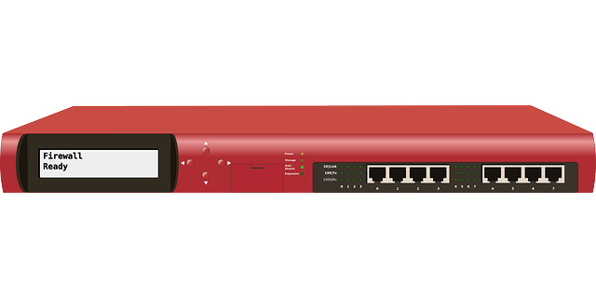
Firewalls - Stateless
Stateless Firewall
(Packet Filtering)
Network A
Network B
Source IP 10.10.10.10
Destination IP 10.10.10.10
Port 443

Slide 3



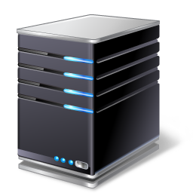
Firewalls - Stateful
Stateful Firewall
SYN
SYN-ACK
(Dynamic Packet Filtering)
ACK
Network A
Network B
Source SYN Pack
Destination SYN-ACK
Source ACK
Notes:
Coordination of a complex operation involving many people, facilities, or supplies.

Slide 4



Firewalls – Content/URL Filtering
Content Filtering
URL Filtering
Internet
http://www.???.???
Text strings, images, embedded objects
URL database
Notes:
Coordination of a complex operation involving many people, facilities, or supplies.

Slide 5
Firewalls – NAT Gateway
Internet
Destination IP 209.251.131.98
Source IP
10.10.10.10
UDP/TCP
Payload
Source IP
Public Address
Notes:
Coordination of a complex operation involving many people, facilities, or supplies.

Slide 6





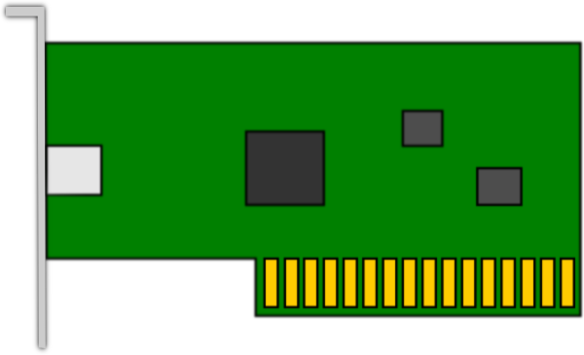
Firewalls – Hardware vs. Software
Internet
Hardware-based
(Network-based)
(Appliance)
Virtual
Subnet A
Subnet B
Software-based
(Host-based)
Notes:
Coordination of a complex operation involving many people, facilities, or supplies.

